Slide 1
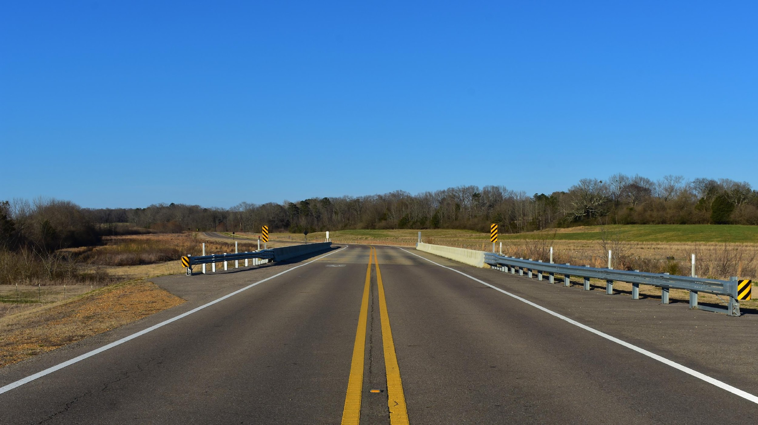

Collide-O-Scope
Ajaya Dahal, Walker Thames, Zachary Sahnger, William Clark, Joseph Westerfield

Slide 2
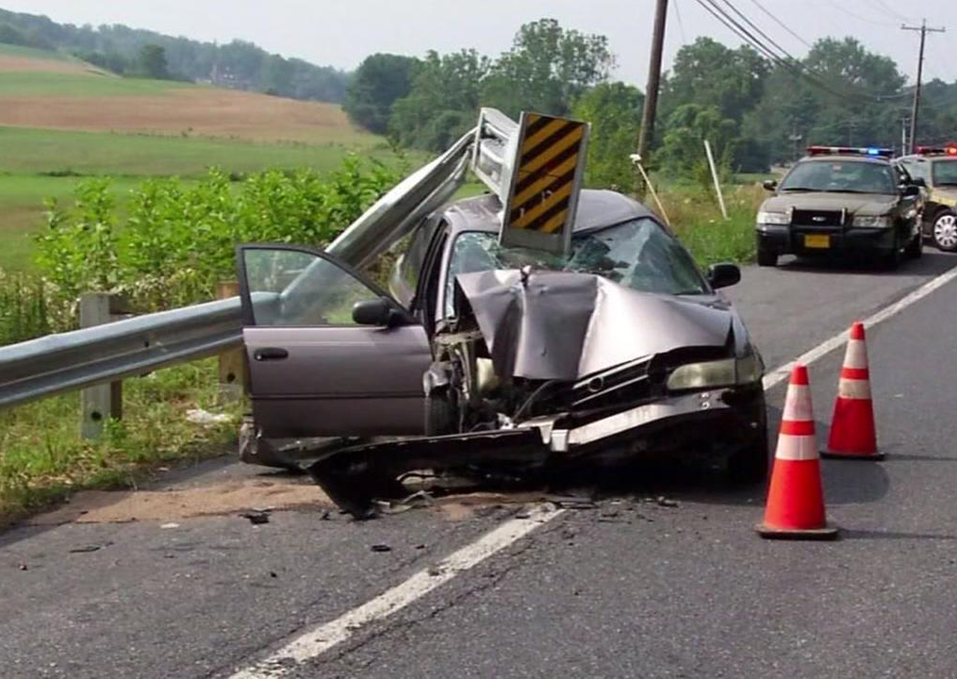

Problem
Our sponsor, Atwood Fencing, provides guardrails to their clients [1]
Terminal ends are meant to be destroyed and replaced
DOT employees travel long distances to check status of TES
A terminal end section destroyed by a car [2]
Notes:
our sponsor, Atwood fencing, approached us with a problem
they are in the business of purchasing and installing TES of guardrails
In fact, They have purchased over 3000 since 2018
Terminal end sections are the end part of the guardrail that are most commonly hit by cars
They are found everywhere, at least 4 required for almost every bridge in the country, as well on the ends of long stretches of guardrails on the highway
these terminal end sections are made to be destroyed, they provide a safe crumple zone at critical points
since these pieces are always being replaced, DOT employees have to travel all over their respective regions to monitor the status of these guardrails, making usre they are in operational condition.
This is a huge waste of taxpayer money on gas and time used to drive out to check on all these locations

Slide 3
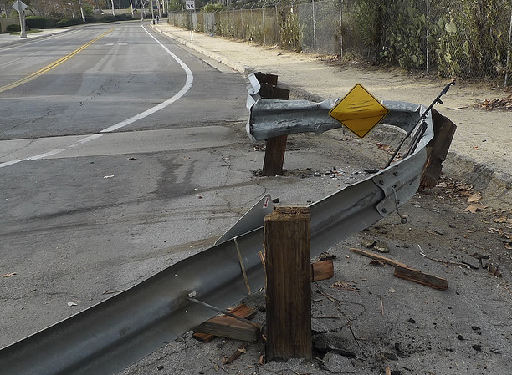

Solution
Design a sensor to monitor guardrail status
Send real-time notification to customers
Collect crash data
A guardrail that has been hit [3]

Slide 4
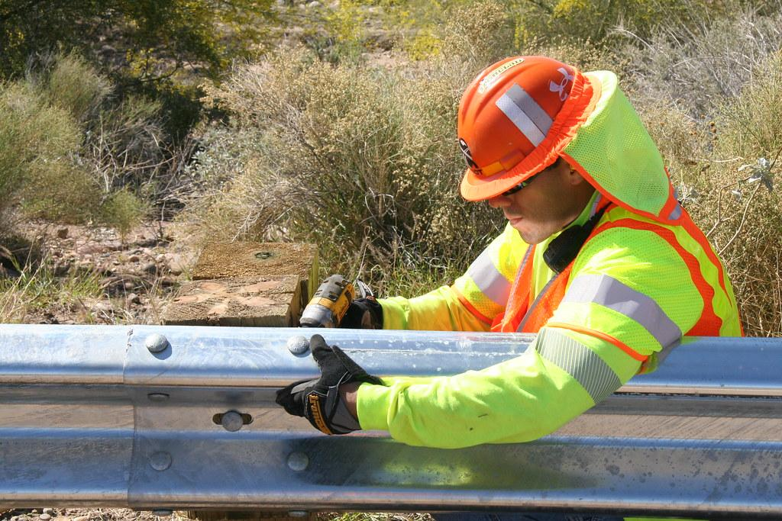

Customers
State DOTs
Federal DOT
DOT contractors
First Responders
A guardrail being worked on [4]
Notes:
Anyone involved in guardrails could benefit
Departments of transportation could know when there is damage
DOT contractors who hire/maintain rails know when their needed (ie. Atwood)
First responders (police, ambulances, etc.) to know when there may have been a wreck

Slide 5
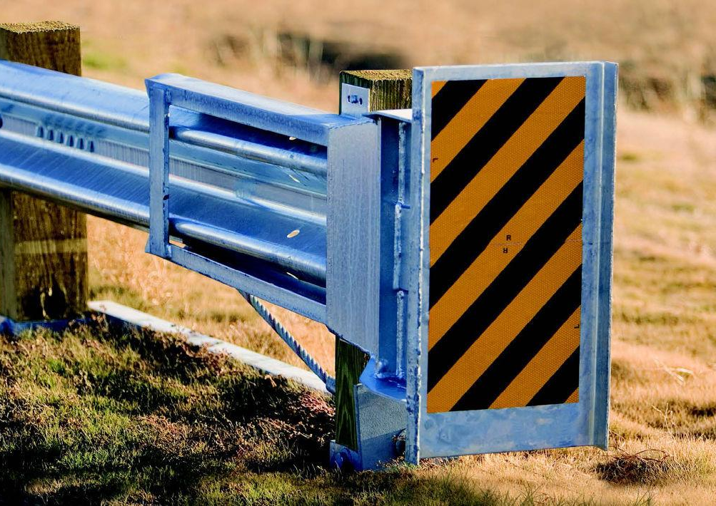

Outreach
Create a website and social media following for advertising
Reach out to state DOTs and contractors
Communicate the necessity of our product with data and analysis
A guardrail end section [5]
Notes:
Joey
Google ads based on key search words such as guardrails

Slide 6
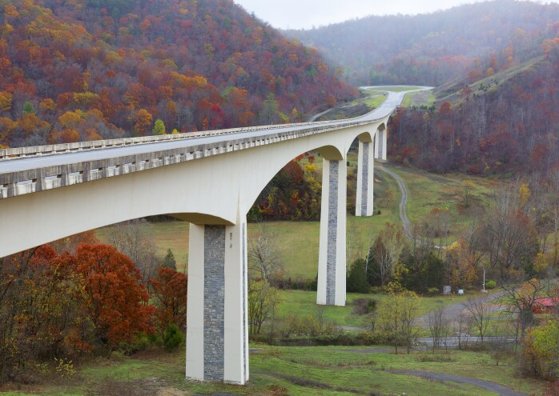

Competition
A patent for a similar product exists but is expired [6]
Traffic cameras can record crashes
IoT in Virginia Smart Roads [7]
A section of a smart road in Virginia [8]
Notes:
TODO: proofread, check references format. Determine why previous patent’s didn’t go anywhere. Discuss how no similar products currently exist. Talk about Smart roads and how it differs from what we’re doing. (sensing pavement conditions, traffic volume, etc)

Slide 7
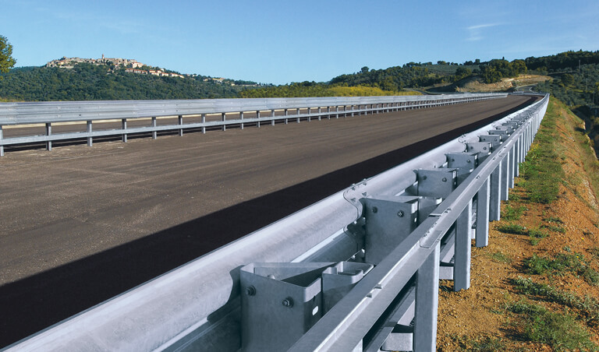

References
[1] N. Wise, Sensor Project - Follow Up, 20-Jan-2022.
‌[2]Go.com, 2022. https://cdns.abclocal.go.com/content/kgo/images/cms/1502726_1280x720.jpg [Accessed Jan. 26, 2022].
[3] Geeklawblog.com, 2022. https://www.geeklawblog.com/wp-content/uploads/sites/528/2012/07/guardrail-3.png.
[4] Arizona Department of Transportation, Guardrail repair along SR 74 near I-17_032514. 2014.
[5]Townnews.com, 2022. https://bloximages.newyork1.vip.townnews.com/richmond.com/content/tncms/assets/v3/editorial/2/51/2510f25e-0d63-5d23-9722-eb583a7cc9c2/56721db656e87.image.jpg?resize=1200%2C710 [Accessed Feb. 02, 2022].
‌[6] Highway Crash Barrier Monitoring System, by Jeffrey A. Geary, David A. Smith. (2003 March 25) US 6539175 B1 [online]. Available: https://patents.google.com/patent/US6539175B1/en
[7] “Facilities,” Virginia Smart Roads: Highway Section | Virginia Tech Transportation Institute. [Online]. Available: https://www.vtti.vt.edu/facilities/highway-section.html. [Accessed: 24-Jan-2022].
[8]M. Moeller and Virginia Tech Transportation Institute, Smarter “Smart Road” Paves the Way for Driverless Vehicles. 2017.

